Slide 1

Soft ip-cores (arm/risc-v processors)
Obi, Nnamdi elijah

Slide 2
What are ip-cores?
An IP core consists of a block of logic or data that is used in a semiconductor chip.
It is usually the intellectual property of a particular person or company.
IP cores are used when making a field programmable gate array (FPGA) or application-specific integrated circuit (ASIC).

Slide 3

Types of ip-cores (differences)
Hard IP-Cores
Firm/semi-hard IP-Cores
Soft IP-Cores

Slide 4
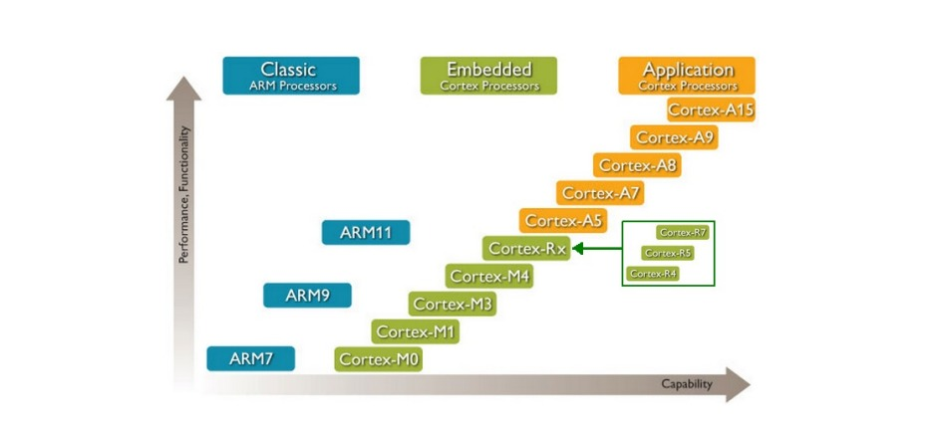
Soft ip-core: arm soft ip-core
HISTORY OF ARM
WHAT IS IT EXACTLY?
USE CASES
EXAMPLES

Slide 5
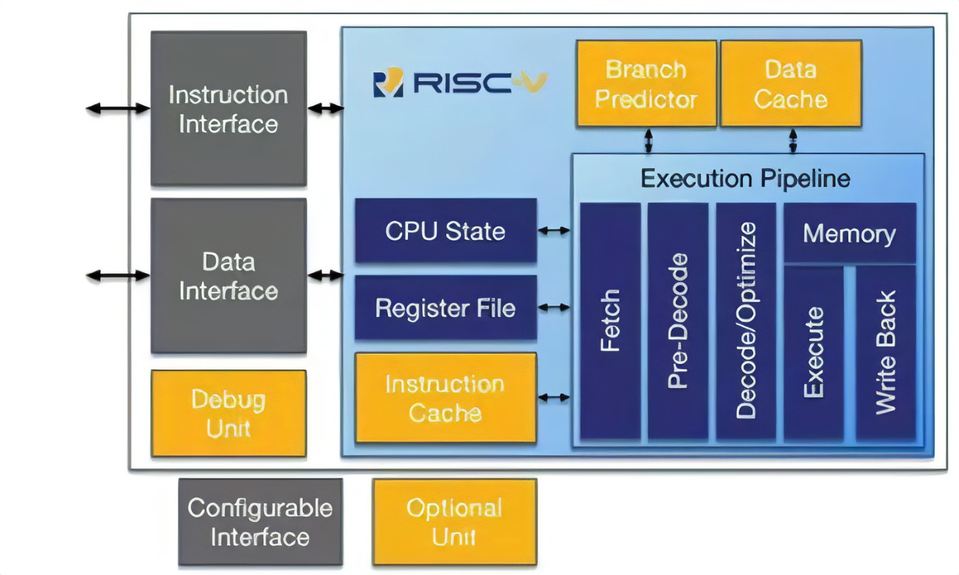
Soft ip-core: risc-v soft ip-core
HISTORY OF RISC-V
WHAT IS IT EXACTLY?
USE CASES

Slide 6
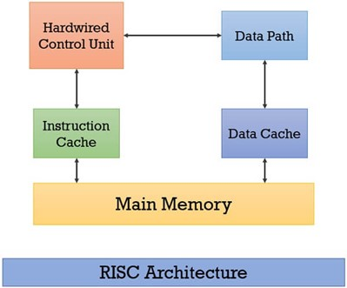
Examples of risc-v soft ip-core
SiFive
PULPino
RIOS
Syntacore, e.t.c

Slide 7
Thank You
CONCLUSION
Soft IP cores offer a number of benefits and limitations that should be carefully considered when deciding whether to use them in a project. Soft IP cores can be a cost-effective and flexible way to implement a processor that is compatible with a particular instruction set architecture (ISA)

